Slide 1


Safe at Scale: Microservices Development and Hosting in the Modern Era
Jinhong Brejnholt
jbrejnholt

Slide 2





Slide 3
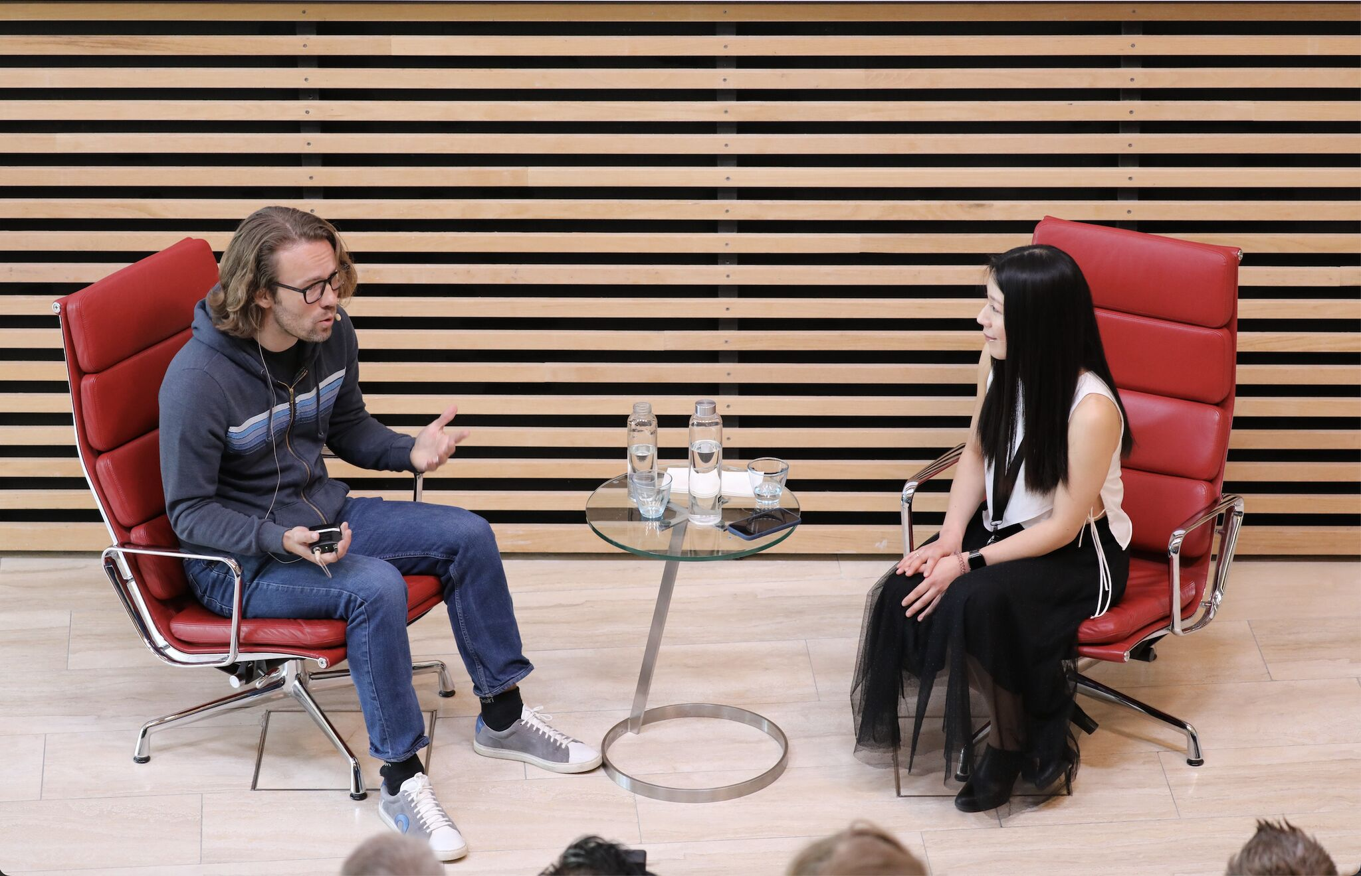
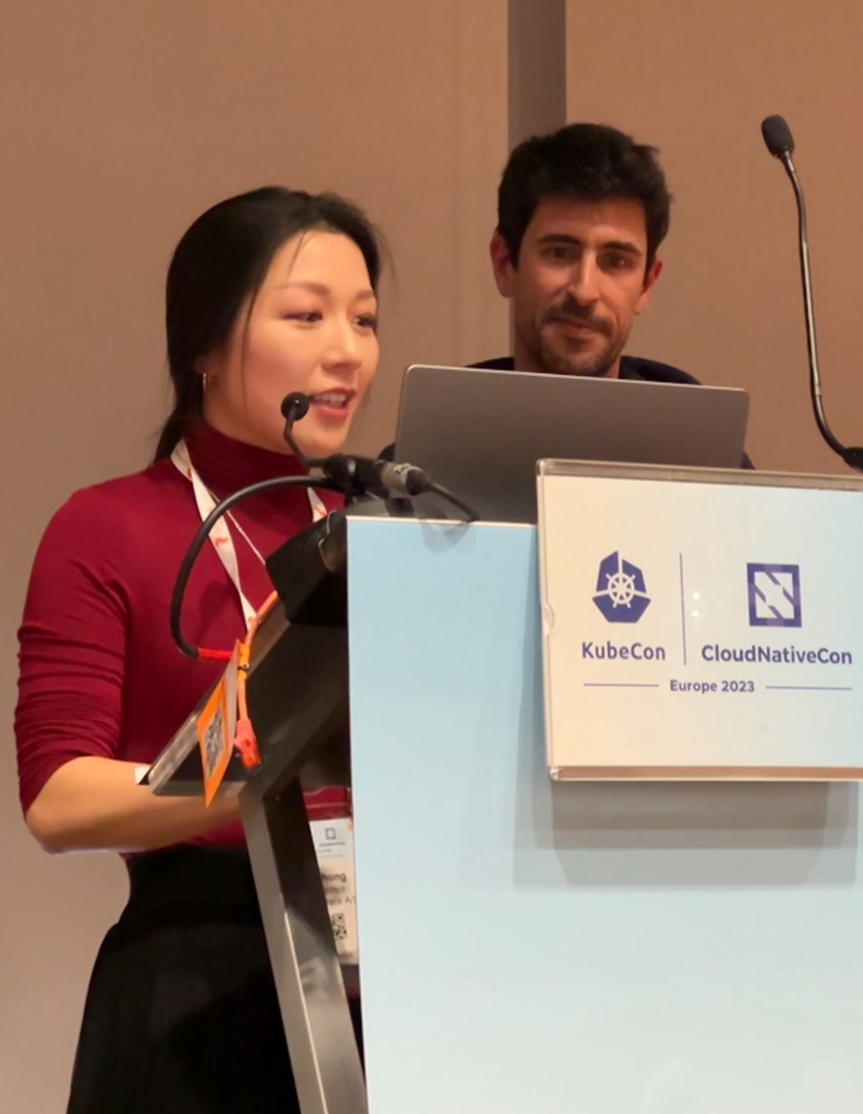
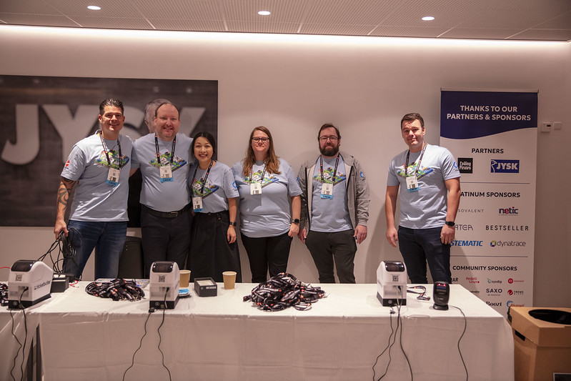
Cloud Native Community
Tuesday, February 2, 20XX

Slide 4


jbrejnholt
Notes:
“Saxo Bank is a very different bank, and we want our environment to reflect that. The T-Rex that hangs in the canteen reminds us that we need to remain agile and be on the leading edge of technology developments so that we can continue to help our clients and partners navigate the global markets. In other words, we cannot become dinosaurs.” --Kim Fournais, CEO and Founder, Saxo Bank
Saxo Bank is a Danish investment bank specializing in online trading and investment. It was founded as a brokerage firm in 1992, under the name Midas Fondsmæglerselskab, by Lars Seier Christensen, Kim Fournais, and Marc Hauschildt. The name was changed to Saxo when the company obtained a banking license in 2001.
Saxo Bank A/S is a fully licensed and regulated Danish bank with an online trading platform that empowers you to invest across global financial markets.

Slide 5

Our Setup
~ 40 Kubernetes clusters (+ number of DCs) and growing
Between 10 to 50 nodes
Around 500 deployments per day
Hybrid Cloud
Kubernetes on premises

Slide 6


Potential Topics
•Understanding Microservices and Best Practices
•Security and Compliance (Authentication, Authorization, Logging)
•Integration Testing in Microservices
•Secure Software Development Lifecycle Management
•Building a Kubernetes Platform and Best Practices (GitOps + built-in security)
•Enabling collaboration between development and operations teams

Slide 7

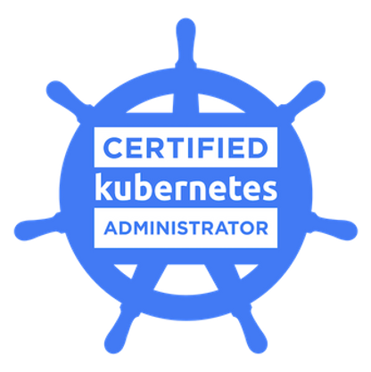




Slide 8

What would I have done differently?

Slide 9

There are many!

Slide 10

Application – template the golden path
Security and Compliance
Authentication and authorization
Data Encryption
Logging and monitoring
Static code analysis
API design principles
Messaging pattern
…

Slide 11
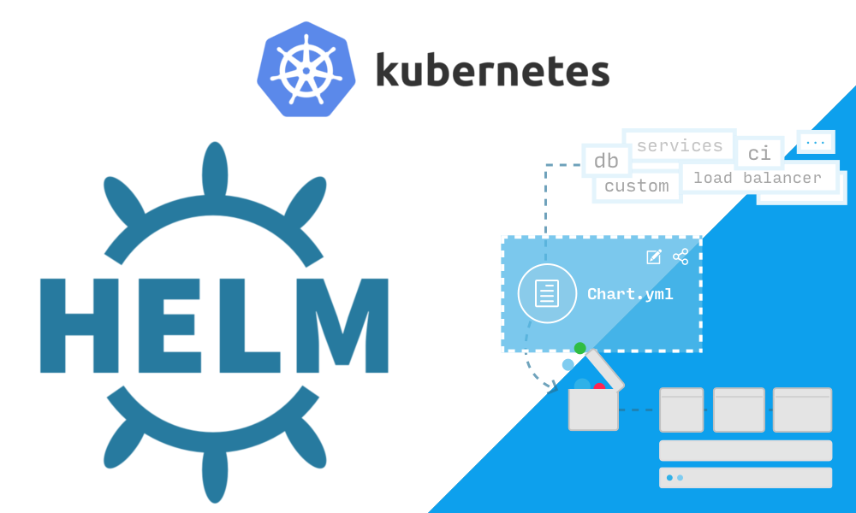

Deployment – Pick one strategy and stick to it
Helm, for example

Slide 12
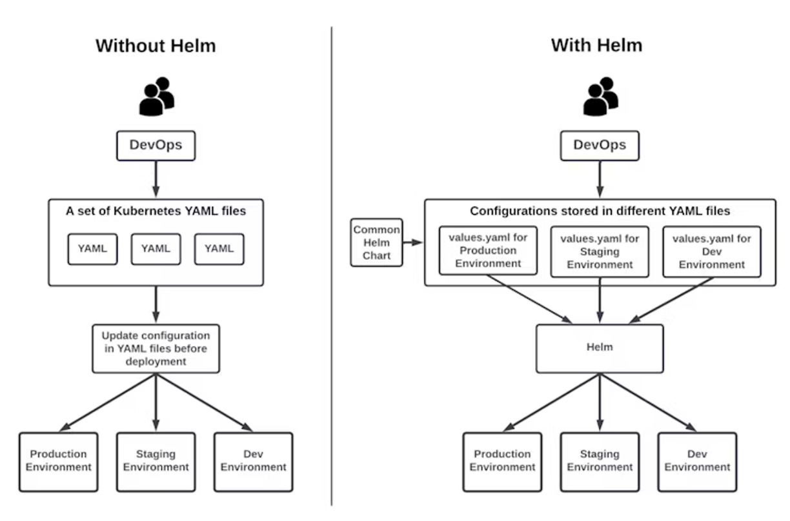

Deployment - Helm
Helm is the best way to find, share, and use software built for Kubernetes.
Template it!

Slide 13
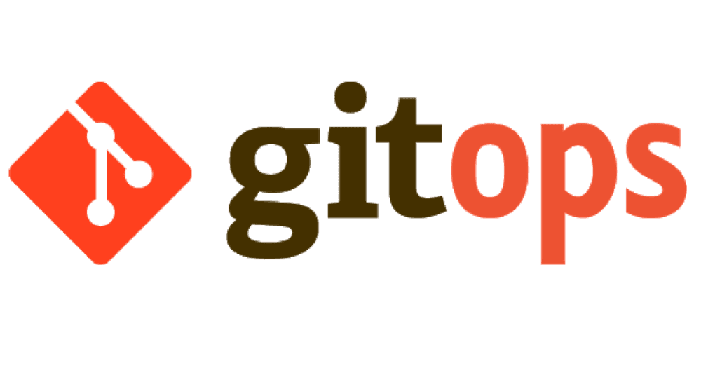


Hosting – GitOps-enabled Kubernetes

Slide 14
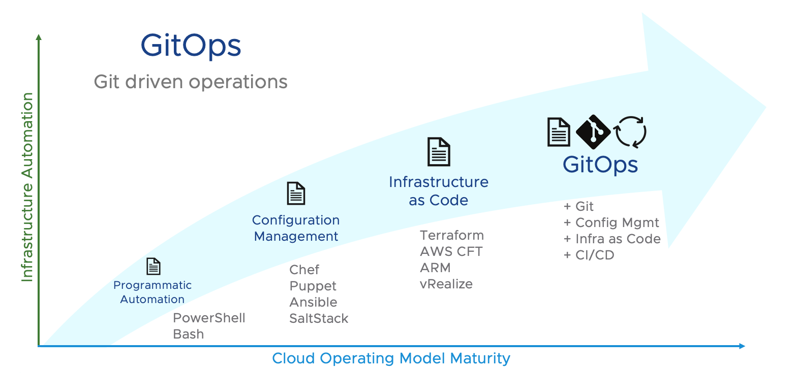
Hosting – GitOps-enabled Kubernetes

Slide 15

GitOps EVERYTHING
This Photo by Unknown Author is licensed under CC BY-SA-NC

Slide 16

Wrap up
Not one size fits all - communication is key
GitOps everything – template your way onto better DevEx
Don’t be afraid of open-source projects

Slide 17

Questions? Let’s Talk!

